Slide 1
Book 1, Unit 20

Slide 2
Roots
Roots Meaning Origin
Medi middle Latin
Semi/hemi half Latin
Equ even, level Latin

Slide 3
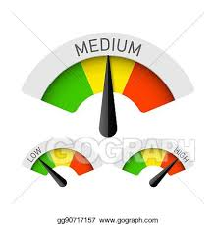
medium
Definition-(adj.) in the middle of a range of possible sizes, amounts, etc.
Sentence-I wasn’t sure I could finish a large coffee, so I ordered a medium one.

Slide 4
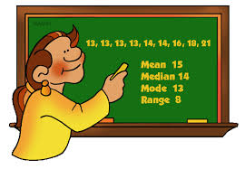
median
Definition- (n) a mathematical term that refers to the middle value in a series of numbers arranged from smallest to largest.
Sentence-To find the median of a set of numbers, you must first order them and then count inwards until you get to the middle number(s).

Slide 5
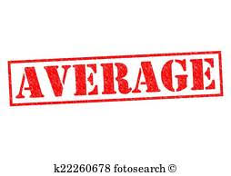
mediocre
Definition- (adj.) not very good, but not very bad either.
Sentence- Since I didn’t dictate much time to practicing, I was just a mediocre piano player.

Slide 6
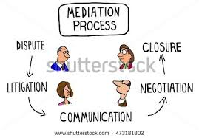
mediate
Definition-(v.) to work with opposing sides in an argument in order to bring about an agreement.
Sentence-When my partner and I disagreed about our project, our teacher came to mediate and find a resolution to our problem.

Slide 7
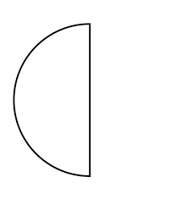
semicircle
Definition-(n.) a half of a circle.
Sentence- We folded the paper circle right down the middle to form a semicircle.

Slide 8
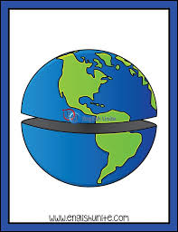
hemisphere
Definition-(n.) one of the halves of the earth as divided by the equator; one of two halves of a sphere.
Sentence- The US and Canada are located in the northern hemisphere of Earth.

Slide 9
semicolon
Definition-(n.) a punctuation mark that can be used to separate major parts in a sentence and to separate items in a series if the items contain commas.
Sentence-The writer used a semicolon to link sentences together that were related to each other.

Slide 10
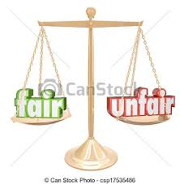
equitable
Definition- (adj.) being fair or just.
Sentence-After bickering for hours, my little sister and I finally agreed on an equitable arrangement for sharing the computer.

Slide 11
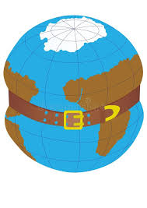
equator
Definition- (n.) an imaginary circle around the middle of Earth, equally distant from the North Pole and South Pole.
Sentence- The climate near the equator is warm and tropical.

Slide 12
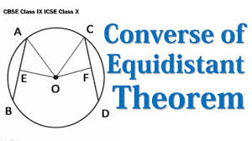
equidistant
Definition- (adj.) Equally distant.
Sentence- The equator is equidistant from the North and South Poles.

